Slide 1

VQA Voyager: Voice-Based Visual Question Answering for Cultural Heritages in Kathmandu Valley
Team Members
Arnab Manandhar
Chandra Mohan Sah
Looza Subedy
Santosh Acharya
(THA077BEI008) (THA077BEI017) (THA077BEI024) (THA077BEI040)
Under the Supervision of
Associate Prof. Suramya Sharma Dahal
Department of Electronics and Computer Engineering
Institute of Engineering, Thapathali Campus
December, 2024

Slide 2
Presentation Outline
• Motivation
• Introduction
• Objectives
• Scope of Project
• Project Applications
• Methodology
• Dataset Analysis
• Results
• Discussion and Analysis
• Remaining Tasks
• References

Slide 3
Motivation
Enhance tourists' cultural understanding and appreciation
Bridge information gaps at heritage sites
Provide interactive, real-time artefact information
Utilize AI for enriched tourist experiences
Foster deeper engagement with cultural heritage
Make heritage sites more accessible
Empower tourists with instant historical insights

Slide 4
Introduction
AI automates mundane tasks, saving time and effort
Opens new possibilities for cultural understanding
CV and NLP methods have potential to significantly improve tourists knowledge
VQA: Promising CV and NLP task
Most common VQA model answers image-related questions
Image and question is taken as input based on which accurate predictions is done

Slide 5
Objectives
To develop a Visual Question Answering (VQA) tool that answers questions based on the object in the captured image
To capture images and create a voice-based app that allows the user to ask questions about the image

Slide 6
Scope of Project
Develop an app to help tourists identify artefacts
Integrate Visual Question Answering (VQA) for image processing and natural language processing
Implement text-to-speech (TTS) and speech-to-text (STT) features
Provide accurate answers to queries about the captured artefacts
Ensure an intuitive and accessible experience for tourists

Slide 7
Project Applications
Assistance in exploring world heritage sites for tourists
Assist users in identifying artifacts and understanding their history
Enhance the cultural experience with detailed information on demand
Provide educational insights about historical objects and artifacts
Enhance engagement through interactive and personalized learning
Promote cultural appreciation and preservation through accessible information

Slide 8
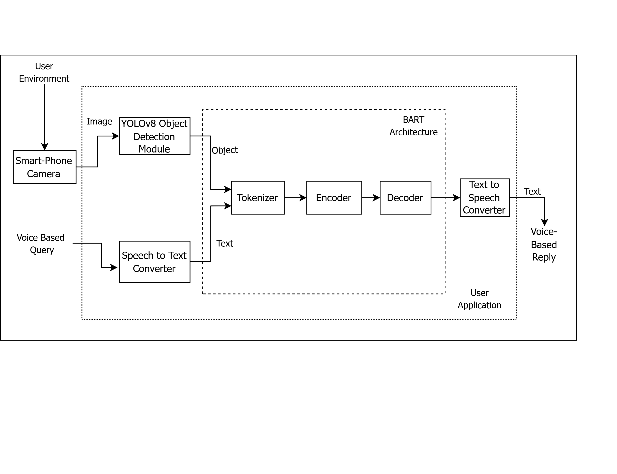
Methodology - [1]
System Block Diagram
Figure: System Block Diagram

Slide 9
Methodology - [2]
Description of Working Principle
User can capture a picture and ask a voice based question
Speech recognition model converts speech to text
The objects in the picture are identified by YOLOv8 model
The object name and question are passed through BART model
BART tokenizes the text and passes it to the encoder
BART decoder provides a descriptive answer
The textual answer is converted into voice based reply using text-to-speech system

Slide 10
Methodology - [3]
YOLOv8 - [1]
YOLOv8 takes image as an input and outputs the bounding box of the objects
Three components: Backbone, Neck and Head
Backbone
Extracts features from images using multiple layers
Neck
Merges feature maps from different stages of the backbone to capture information at various scales
Head
Predict bounding boxes, objectness scores, and class probabilities for each grid cell in feature map

Slide 11
Methodology - [3]
YOLOv8 - [2]
The training parameters for YOLOv8 are:
Hyperparameters | Values
Epochs | 100
Batch size | 16
Image size | 640
Optimizer | AdamW
Learning rate | 0.01
Dropout | 0.0
Hyperparameters | Values
Freeze | null
IoU | 0.7
Box | 7.5
Class | 0.5
DFL | 1.5

Slide 12
Methodology - [4]
BART (Bidirectional Autoregressive Transformer)- [1]
Utilizes separate encoder and decoder components, enabling sequence-to-sequence learning
Uses bidirectional encoder and auto regressive decoder
Encoder
processes the input text bi-directionally from both past and future tokens to create rich contextual embeddings
Decoder
It predicts the next tokens by taking the previously generated tokens into consideration (Auto-regressive)
Generates the answer based on given question and object

Slide 13
Methodology - [4]
BART (Bidirectional Autoregressive Transformer)- [2]
The training parameters for BART are:
Hyperparameters | Values
epochs | 14
batch size | 8
optimizer | AdamW
learning rate | 0.00021
Hyperparameters | Values
warmup steps | 784
num beams | 8
dropout | 0.200
attention dropout | 0.320

Slide 14
Methodology - [5]
Web Application - [1]
Backend Server
User Interface
Session
Deployment

Slide 15
Methodology - [5]
Web Application - [2]
Backend Server : System responsible for managing and processing data behind the scenes of an application
Responsibilities :
Processes API requests and sends responses.
Manages authentication and authorization.
Connects to and interacts with databases.
Technology used : Django, DRF
Deployment : Deployed locally

Slide 16
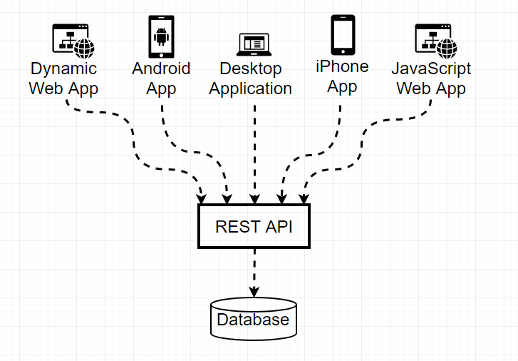
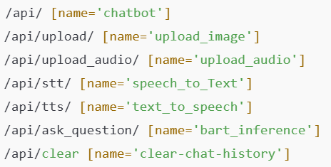
Methodology - [5]
Web Application - [3]
Application Programming Interface
Set of rules and protocols that allow different software application to communicate with each other.
Figure 1: Cross Platform Development
Figure 2 : Various API Created

Slide 17
Methodology - [5]
Web Application - [5]
Exception Handling (four cases) :
Gibbresh Test :
Identifies nonsensical user input (e.g., "sdkfjnsdjfbs").
Provides prompt: "I'm sorry, I couldn't understand that. Could you rephrase?“
Unidentified Images:
Identifies Unidentified images :
Provides prompt: "No object detected in the images.“

Slide 18
Methodology - [5]
Web Application - [5]
Questioning before image upload :
Provides prompt: “No object detected to inquiry about. Please upload an image.“
Multiple object detection handling:
Lists detected objects from uploaded images.
User selects any specific object.
Enables context-specific question answering.

Slide 19
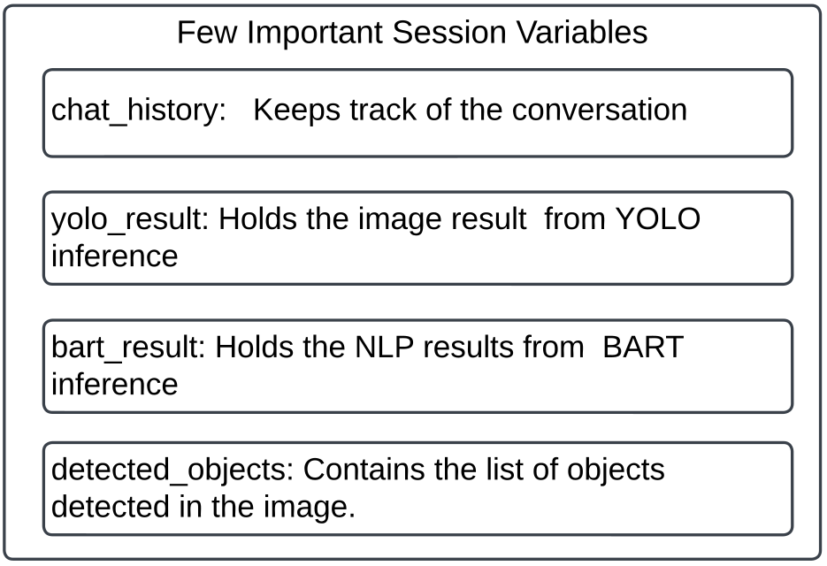
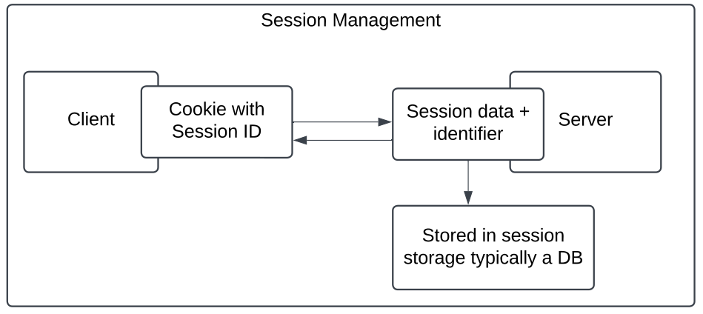
Methodology - [5]
Web Application - [4]
Session Management:
An “ongoing connection” between a client(browser) and server.
Data stored in a session persists as long as the session is active.
Figure 1 : Important Session
Figure 2 : Session Management

Slide 20
Methodology - [5]
Web Application - [5]
Time Complexity Analysis :
1. YOLO Inference
Average Time: 0.1519 seconds per image.
Time Complexity: O(n) (n = number of pixels).
Key Insight: Fast, real-time object detection.
2. BART Text Generation
Average Time: 1.3622 seconds per question.
Time Complexity: O(m * d) (m = input length, d = model depth).
Key Insight: Longer inputs take more time.
3. Measurement
Tool: time.time() in Python.
Conclusion: Efficient for real-time image and text tasks.

Slide 21
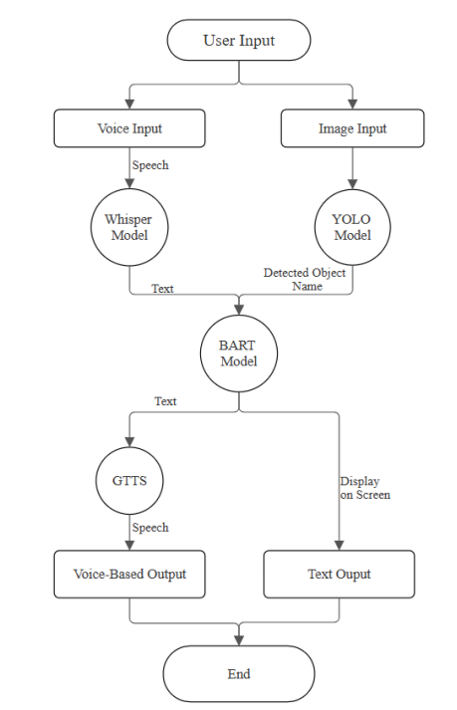
Methodology - [5]
Web Application - [6]
Software Workflow
Communication Hierarchy between
Various components can be seen in the given diagram.
Figure : Software Workflow

Slide 22
Dataset Analysis - [1] Data Collection - [1]
Images were collected through site visits around Kathmandu Valley
Additional images obtained by web scraping from Shutterstock and existing datasets
The final dataset contains
6812 images
12 classes

Slide 23
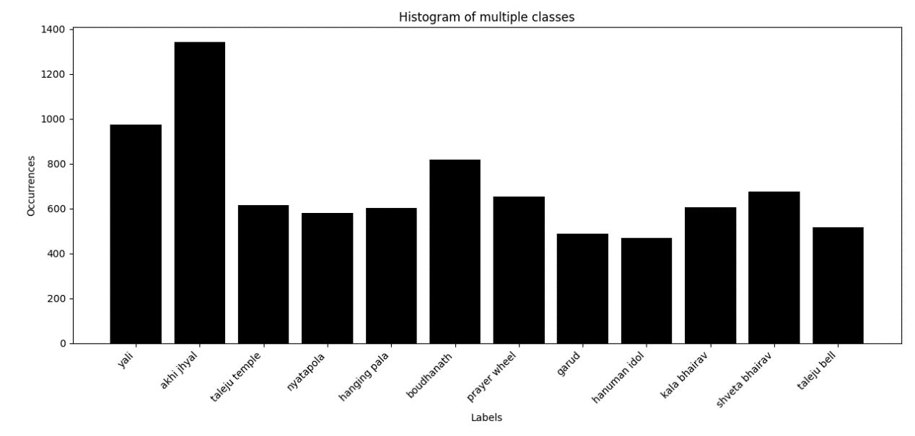
Dataset Analysis - [1] Data Collection - [2]
Distribution of images in dataset
Figure: Image Distribution

Slide 24
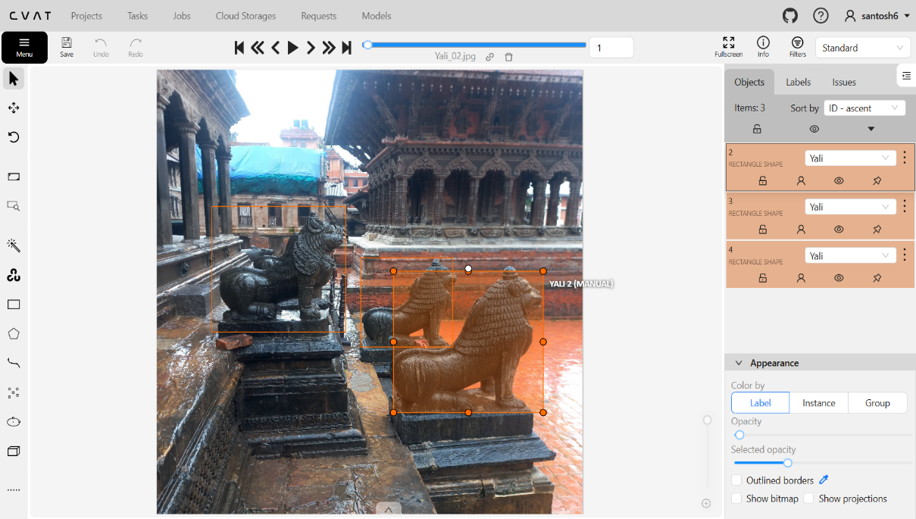
Dataset Analysis - [2] Data Annotation
CVAT is used for annotation of images
Bounding box and class labels added
Exported in YOLO format for training
Figure: Annotation using CVAT

Slide 25
Dataset Analysis - [3] Data Augmentation
Five images generated using random combination of augmentation techniques
Horizontal flipping
Brightness and contrast
Gamma adjustments
Gaussian noise and blur
Rotation
Figure: Data Augmentation

Slide 26
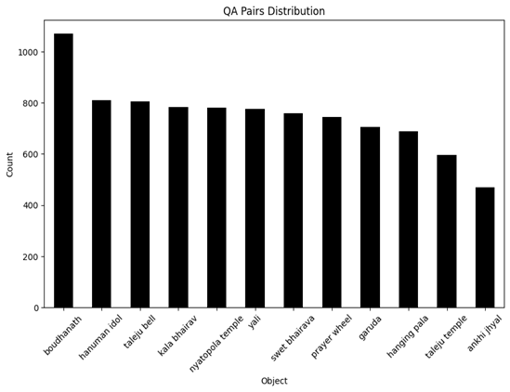
Dataset Analysis - [4]
Total of 8898 question answer pairs for all classes.
An average of 765 question answer pairs for each of the 12 classes.
Figure: QA Pairs Distribution

Slide 27
Dataset Analysis - [5] Data Augmentation Techniques - [1]
Embedding Augmentation
Subtly altering word embeddings, semantically similar, syntactically varied
Random Deletion
Removing random words, preparedness for fragmented user inputs
Translation-based Augmentation
Translation to other languages and back
WordNet-based Augmentation
Replace words with synonyms to enhance vocabulary diversity

Slide 28
Dataset Analysis - [5] Data Augmentation Techniques - [2]
Original Question | Augmentation Technique | Augmented Question
Which god is present in Taleju Temple? | Embedding Augmentation | Which deity is present in Taleju Temple?
Which god is present in Taleju Temple? | Random Deletion | Which god present in Taleju Temple?
Which god is present in Taleju Temple? | Translation-based Augmentation | ताजेलू मंदिर में कौन सा देवता है? (Translated from Hindi and back to English: Which deity is present in Tajelu Temple?)
Which god is present in Taleju Temple? | WordNet-based Augmentation | Which god is found in Taleju Temple?

Slide 29
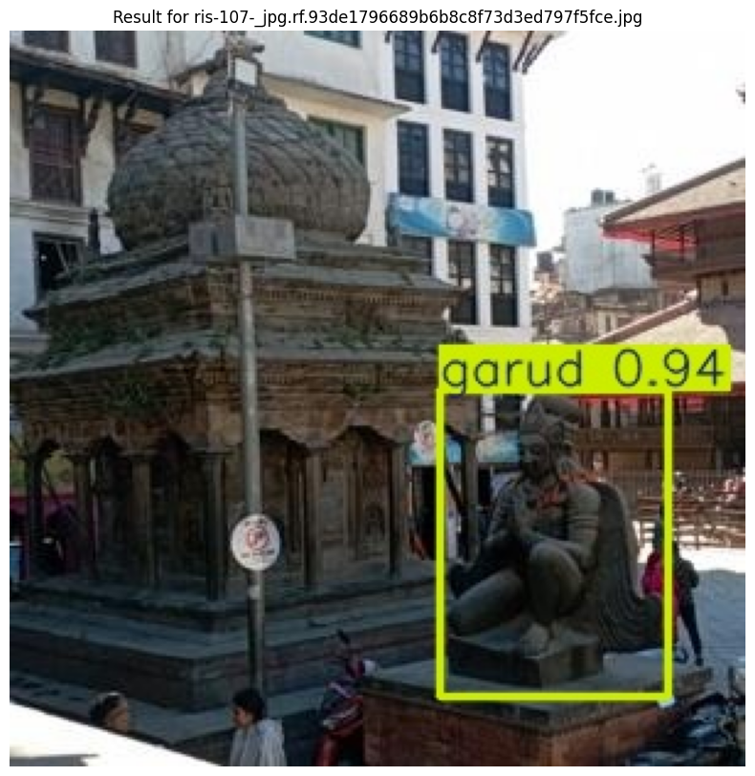
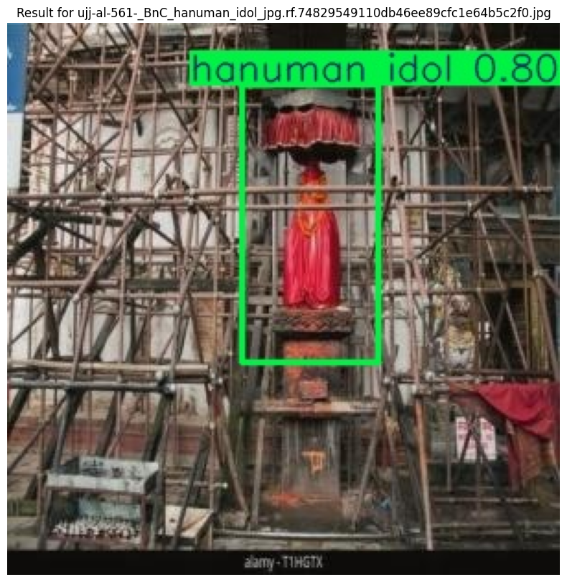
Results - [1] - Object Detection Module - [1]
The Inference Results of YOLOv8 are:
Figure: YOLOv8 Inference Results

Slide 30
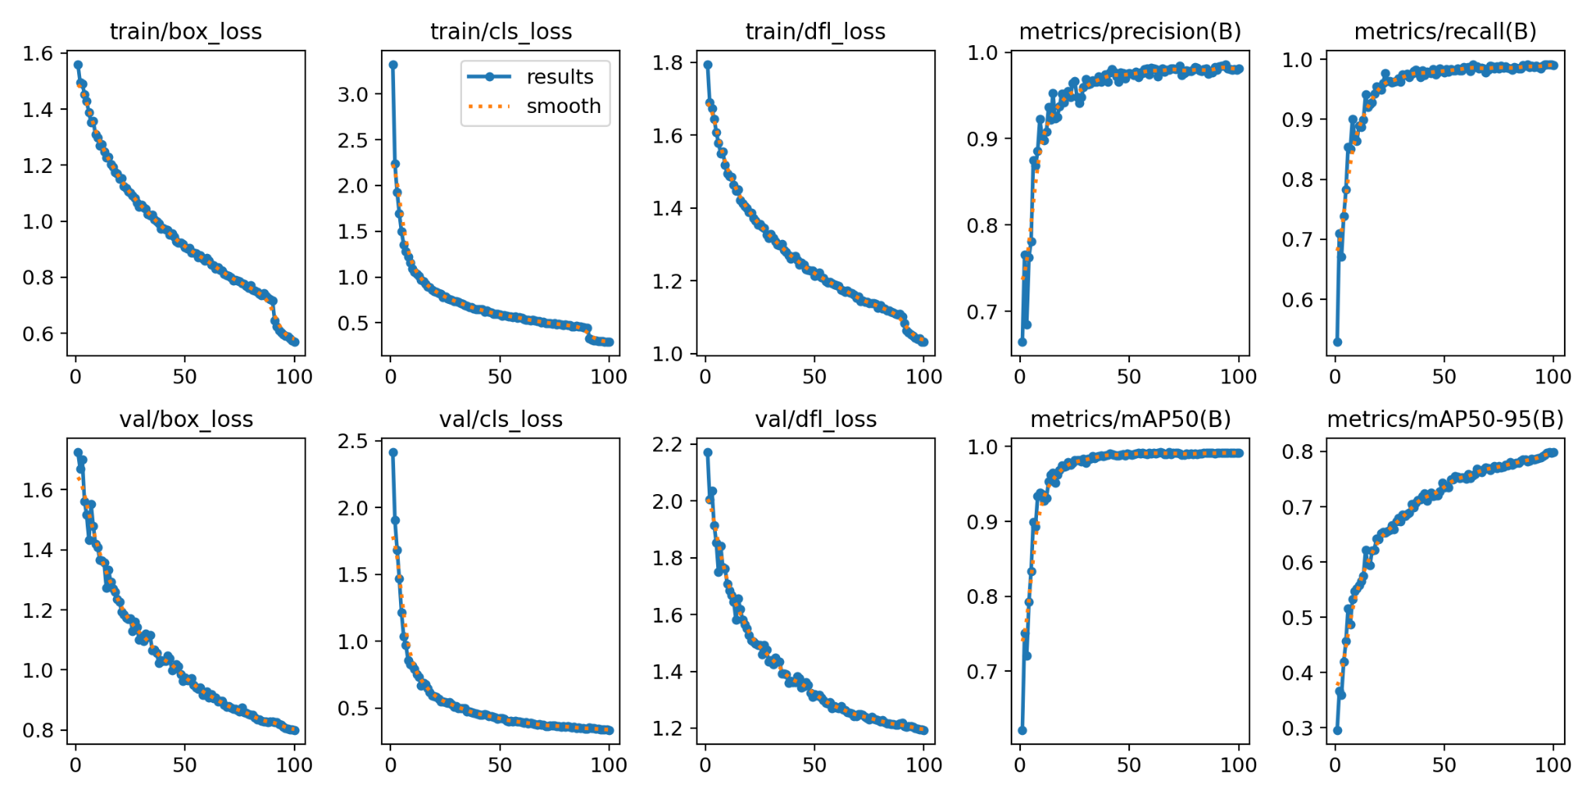
Results - [1] - Object Detection Module - [2]
Losses and metrics curve
Figure: Losses and metrics curve

Slide 31
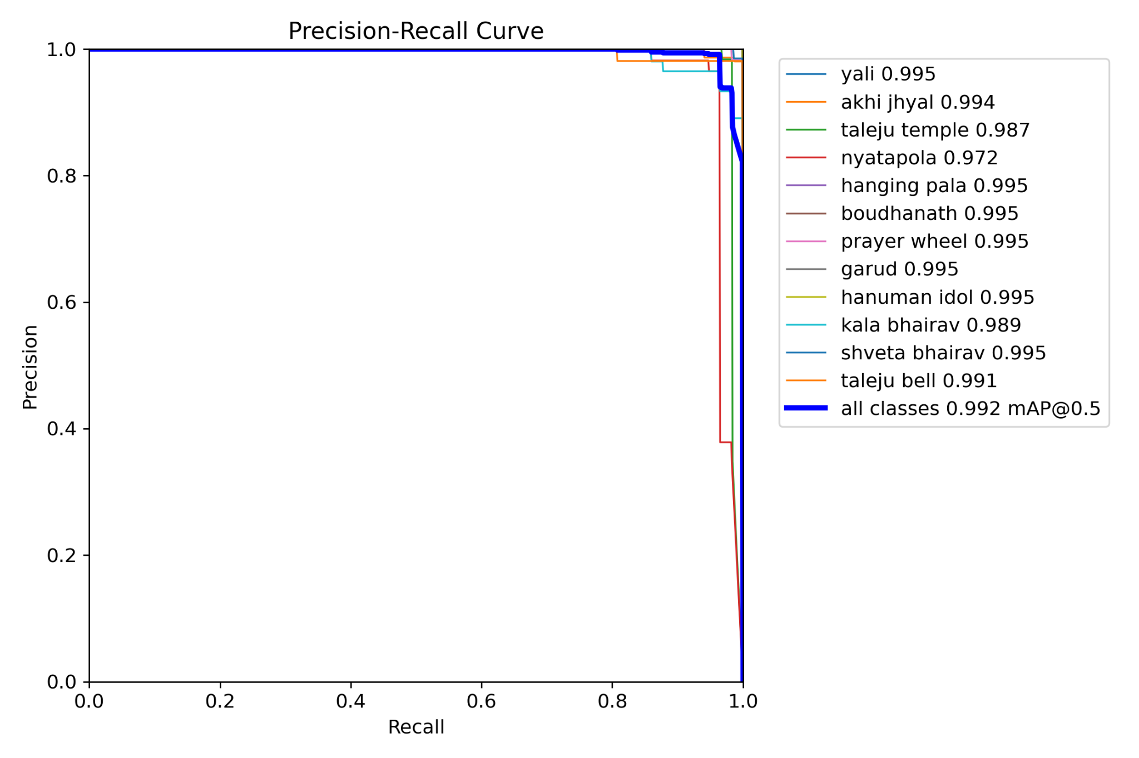
Results - [1] - Object Detection Module - [3]
Precision Recall curve
Figure: Precision Recall curve

Slide 32
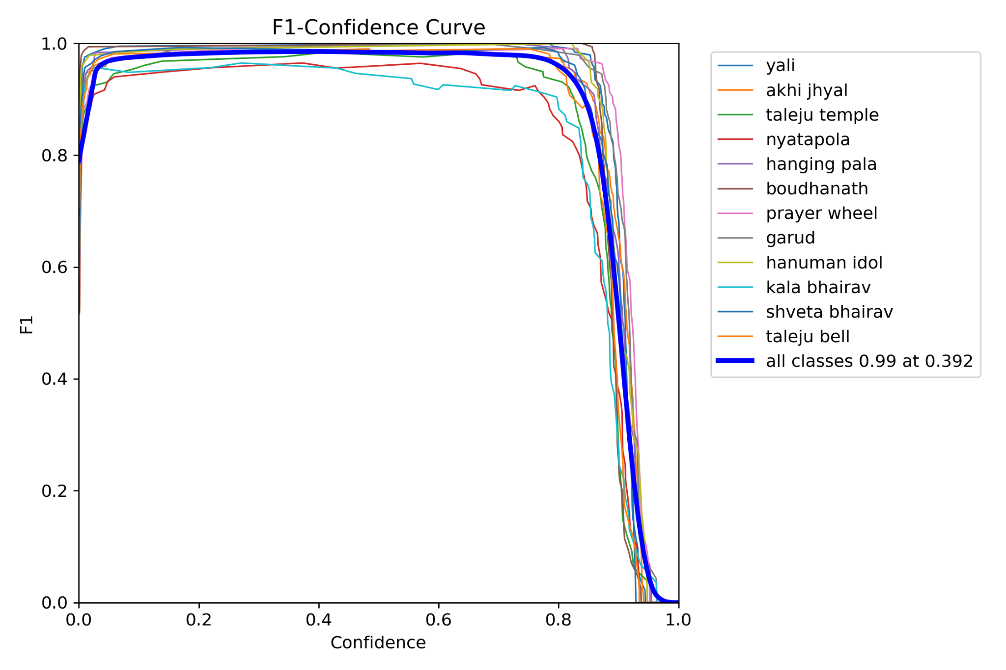
Results - [1] - Object Detection Module - [4]
F1-score curve
Figure: F1-score curve

Slide 33
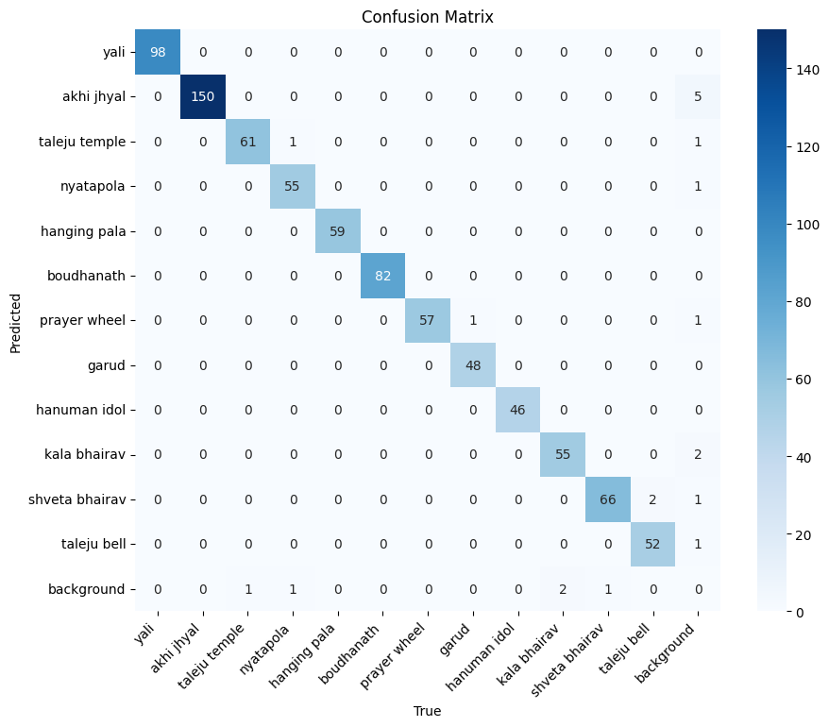
Results - [1] - Object Detection Module - [5]
Confusion Matrix
Figure: Confusion Matrix

Slide 34
Results - [2]
BART Inference Results
Answers generated by BART
Question | Original Answer | Generated Answer
what does the phrase 'turning the wheel of dharma' describe ? | it describes the way in which the buddha taught, and the prayer wheel is a physical manifestation of this concept. | it describes the way in which the buddha taught, and the prayer wheeled is a physical manifestation of this notions.
what is the alternative term used by newar inhabitants outside of bhaktapur when referring to the temple ? | people of newar descent living away from bhaktapur commonly refer to the temple as 'nyātāpau.' | outside bhaktapur, the newar people use the term 'nyātāpau' to refer to the temple.
what direction do pilgrims stroll when turning prayer wheels at monasteries ? | pilgrims stroll in a clockwise direction when turning prayer wheels. | pilgrims stroll in a clockwise direction when turning prayer wheels.

Slide 35
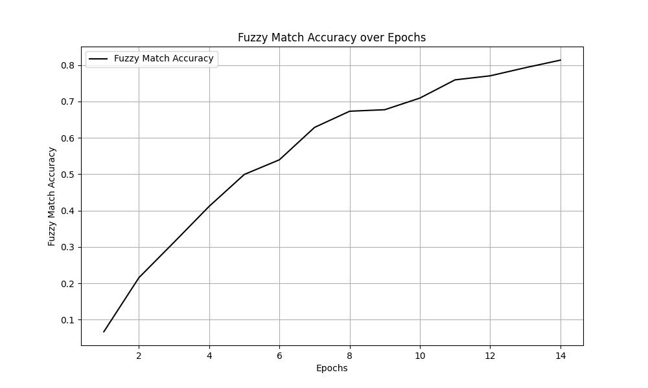
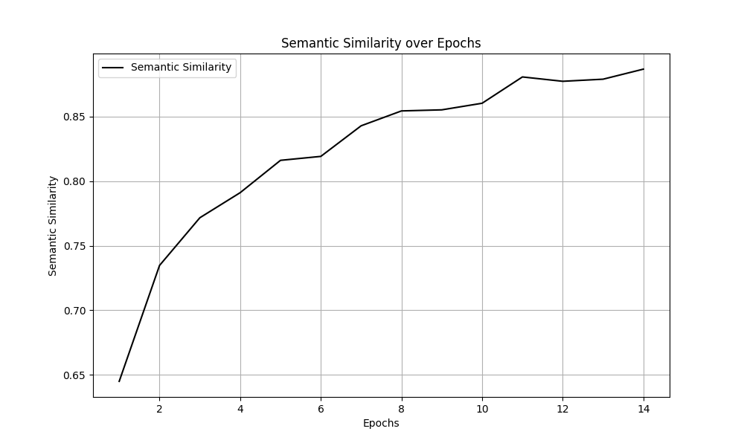
Results - [2]
BART Training Results - [1]
Fuzzy Match Accuracy and Semantic Similarity
Figure: Fuzzy Match Accuracy and Semantic Similarity

Slide 36
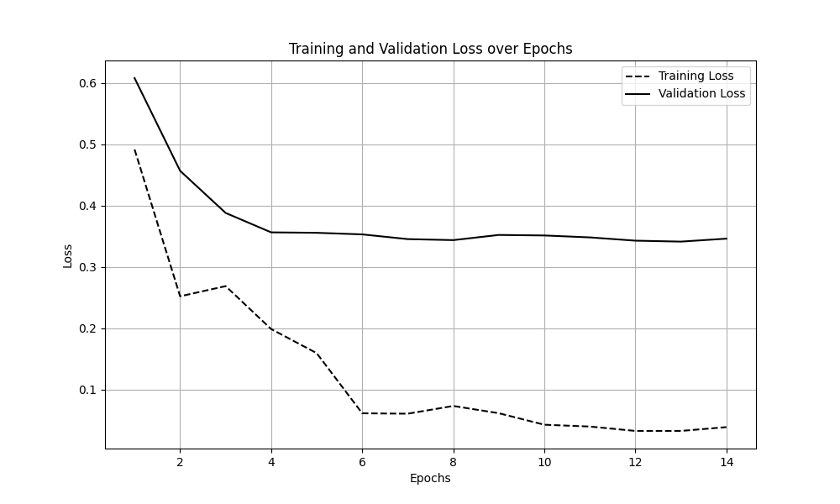
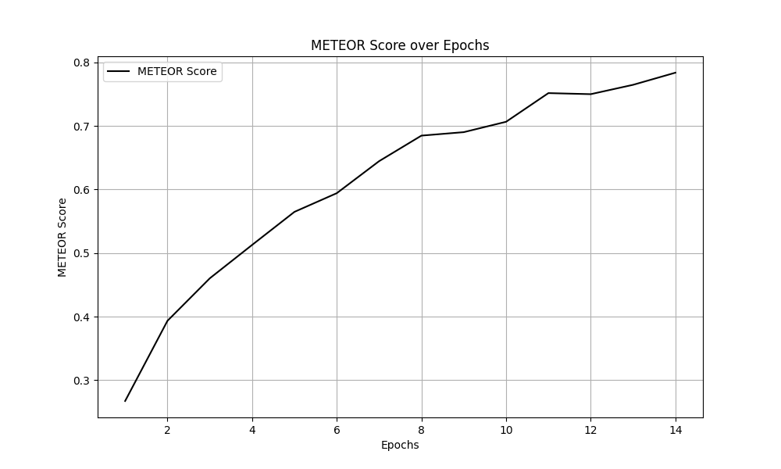
Results - [2]
BART Training Results - [2]
Losses and METEOR Score
Figure: Losses and METEOR Score

Slide 37
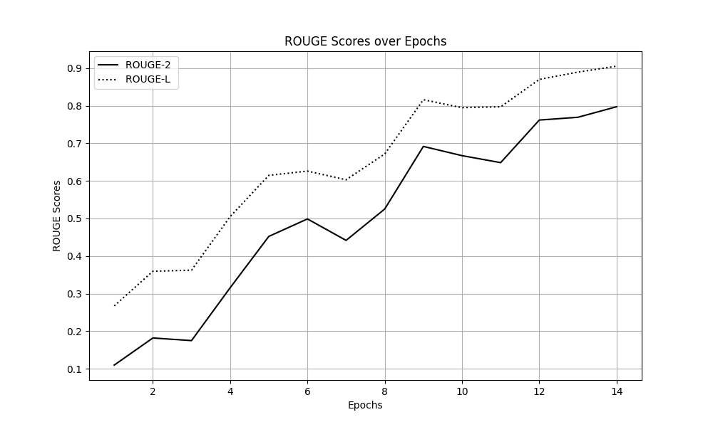
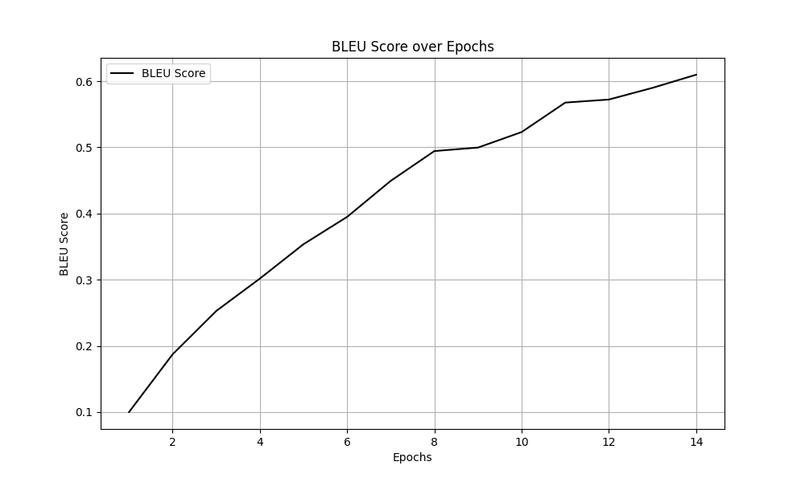
Results - [2]
BART Training Results - [3]
ROUGE Score and BLEU Score
Figure: ROUGE Score and BLEU Score

Slide 38
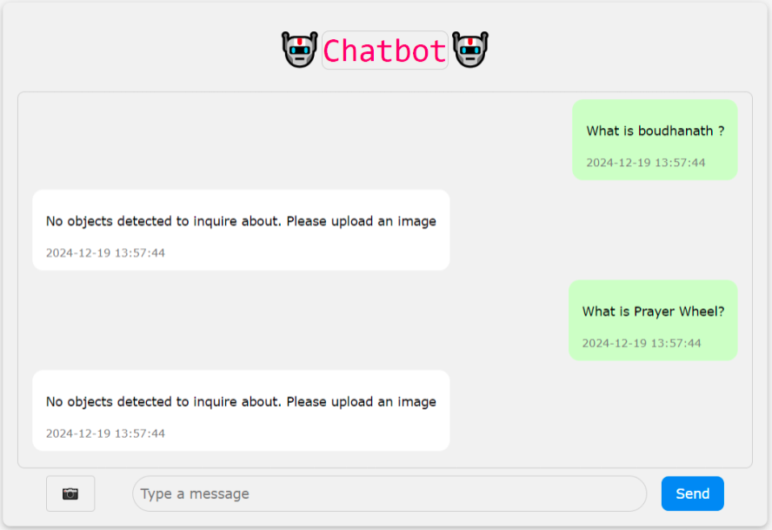
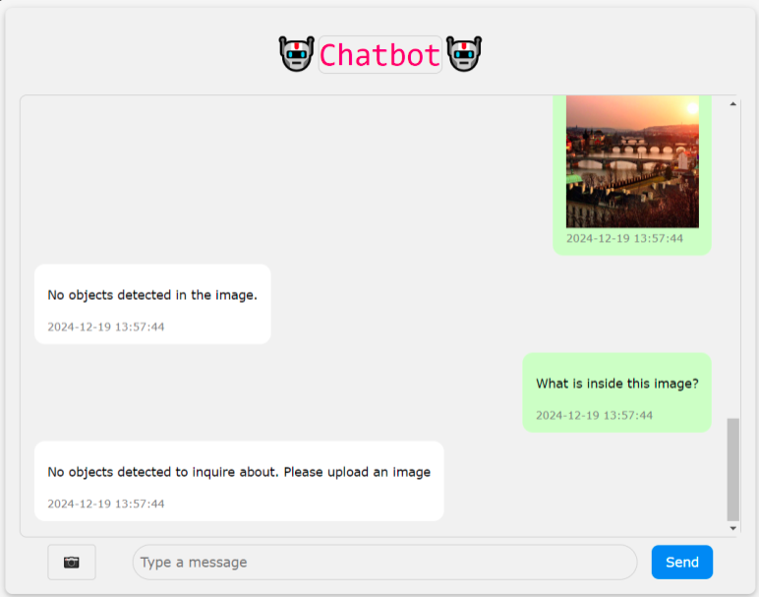
Results - [3] – Chatbot Results - [1]
Figure: Pre-upload Inquiry and unidentified object

Slide 39
Results - [3] – Chatbot Results - [2]
Figure: Post-upload Inquiry

Slide 40
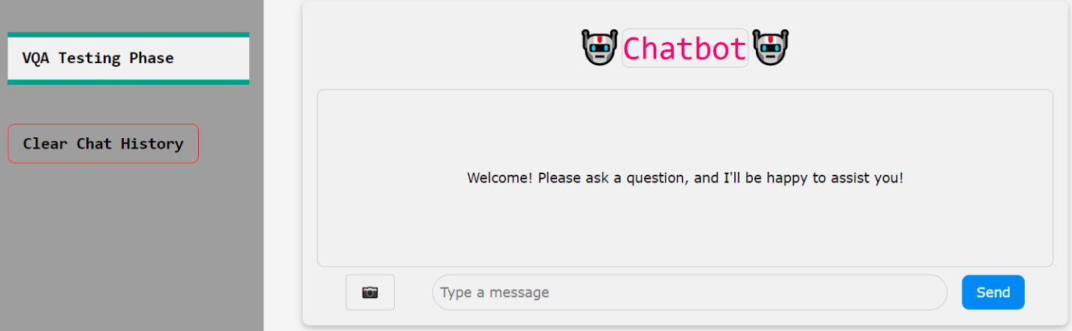
Results - [3] – Chatbot Results - [3]
Figure: Follow-up After Clearing History

Slide 41
Discussion and Analysis – [1]
The maximum values of evaluation metrics were obtained to be as follows:
Precision: 98.62%
Recall: 99.17%
mAP50: 99.23%
mAP90: 79.89%
The evaluation metrics of BART were found to be as follows:
Fuzzy match accuracy: 81%
Meteor Score: 78%
Semantic Similarity: 88%
BLEU Score: 60% ROUGE-2: 79%

Slide 42
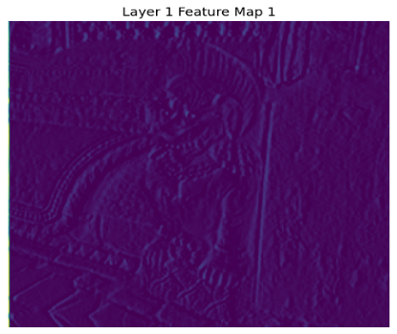
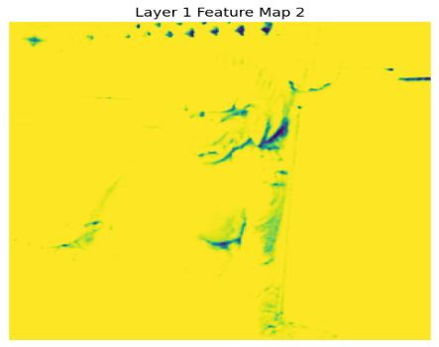
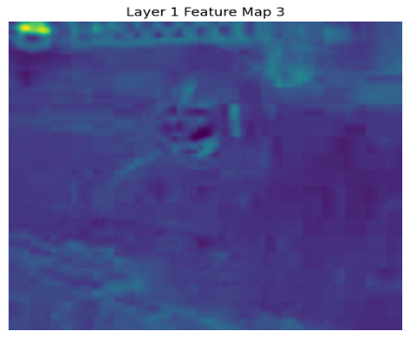
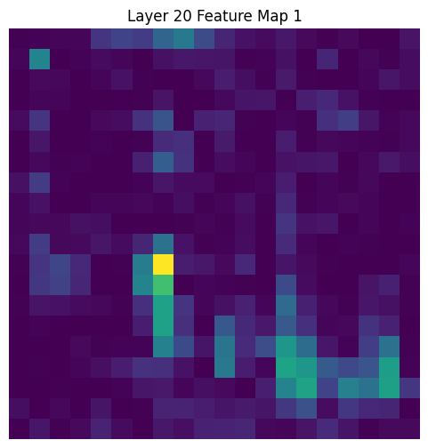
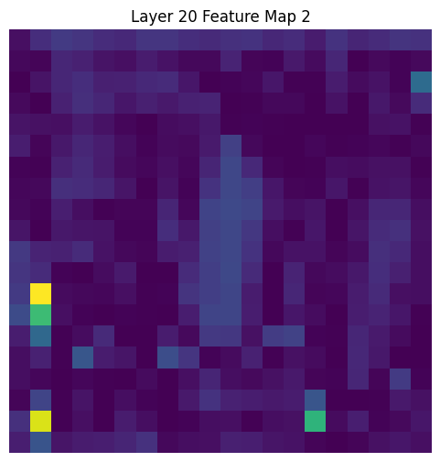
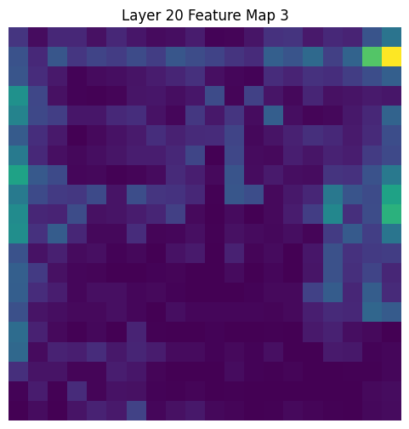
Discussion and Analysis – [2]
Layer 1 captures high level features while the layer 20 captures more finer details.
Figure: Feature maps of YOLOv8

Slide 43
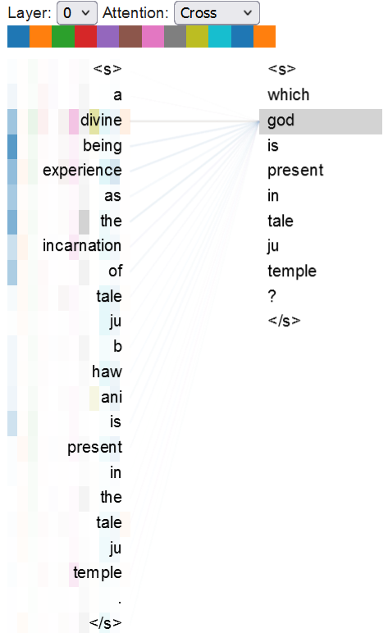
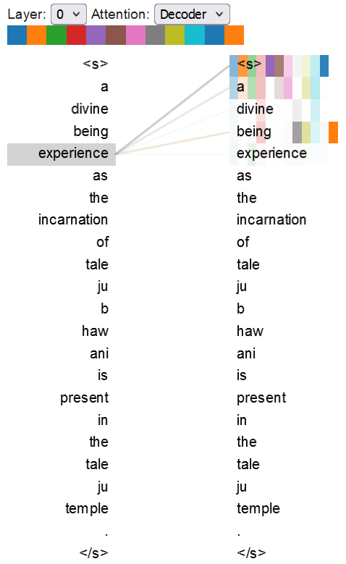
Discussion and Analysis – [3]
Attention maps of BART show it’s autoregressive property and relation between input and output texts.
Figure: Attention Maps of BART

Slide 44
Discussion and Analysis – [4]
The web application is currently hosted locally.
Loads the YOLO model for image detection.
Displays original and detected images in the chat interface.
Supports the BART model for question answering.
Includes a "Clear Chat History" feature to remove previous conversations.

Slide 45
Remaining Tasks
Evaluate the Whisper Speech Recognition Model
Ensure reliable and accurate transcription results.
Develop Android App
Improve user experience and overall application functionality
Session and Conversation Management
Ensure that the past conversations play a role in answering the future queries.

Slide 46
References - [1]
[1] |  | M. M. a. M. Fritz, "Towards a Visual Turing Challenge," 2015.
[2] |  | S. A. e. al, "VQA: Visual Question Answering,," in 2015 IEEE International Conference on Computer Vision (ICCV), Santiago, Chile, 2015.
[3] |  | M. R. Mateusz Malinowski, "Ask Your Neurons: A Neural-based Approach to Answering Questions about Images," in Conference: International conference on computer vision (ICCV), Santiago, 2015.
[4] |  | R. K. a. R. Z. Mengye Ren, "Image Question Answering: A Visual Semantic Embedding Model and a New Dataset," in Deep Learning Workshop at ICML 2015, 2015.
[5] |  | N. P. H. S. B. H. Hyeonwoo, "Image Question Answering Using Convolutional Neural Network with Dynamic Parameter Prediction," in 2016 IEEE Conference on Computer Vision and Pattern Recognition (CVPR), Las Vegas, 2016.

